Slide 1


OBIS Nodes and Contributing to OBIS Canada
Notes:
OK, so I’m going to run through a couple of higher level things, a ‘why is all this happening, who’s doing this’ sort of background. I’ll talk about the different tiers of OBIS node, and more about what OBIS Canada’s duty is as the national OBIS node. Some context we’ll try and give first, how the OBIS system nests within the Intergovernmental Ocean Commission, how the IOC data policy works, that will give everyone a chance to consider its obligations, what OBIS will and won’t do with your data, and help you make sure its policies don’t clash with any of the policies at your institutions for certain datasets. In the era where we are becoming more aware of data ownership and protection considerations such as OCAP and CARE in addition to our commitments to FAIR principles for data sharing, we may find instances where pushing data into the OBIS system for certain projects might not meet obligations you’ve made to partners or will require their buy-in or input before releasing it via the OBIS publication licenses.

Slide 2



UNESCO
United Nations Educational, Scientific and Cultural Organization
IOC
Intergovernmental Oceanographic Commission
IODE
International Oceanographic Data and Information Exchange
OBIS
Ocean Biogeographic Information System
Notes:
So the general shape of the organizations is this. OBIS is a project of UNESCO’s Intergovernmental Oceanographic Commission, within the International Oceanographic Data and Information Exchange.

Slide 3
What is IOC?
Intergovernmental Oceanographic Commission
of UNESCO is the United Nations body for
ocean science
ocean observatories
ocean data and information exchange
Capacity development and marine technology transfer
and ocean services such as Tsunami warning systems.
Its mission is…
to promote international cooperation and to coordinate programmes in research, services and capacity building to learn more about the nature and resources of the oceans and coastal areas
to apply this knowledge to improved management, sustainable development and protection of the marine environment and the decision making processes of States.
Notes:
IOC is UNESCO’s ocean science arm, focused on ocean data and information exchange and capacity development. OBIS helps the IOC fulfill its mission by acting as a far-reaching and diverse international body of biological ocean data professionals and bringing us together to aggregate and curate a body of biodiversity knowledge that is increasingly useful to management decisions and marine protection.

Slide 4
"International Oceanographic Data and Information Exchange”
A program of the "Intergovernmental Oceanographic Commission" (IOC) of UNESCO
Established in 1961.
Purpose is to enhance marine research, exploitation and development, by facilitating the exchange of oceanographic data and information between participating Member States, and by meeting the needs of users for data and information products.
For more see http://www.iode.org
Notes:
Within the IOC is the International Oceanographic Data and Information Exchange, helping us move data and information about the global ocean between the Member States, and in turn providing us data and information products.

Slide 5

Background
OBIS is the world’s largest open access, online repository of spatially referenced marine life data that:
Nations can use to develop national and regional assessments, to discover trends, gaps and biodiversity hotspots and to meet their obligations to the Convention on Biological Diversity and other international commitments.
Stimulates research about our oceans to generate new hypotheses concerning evolutionary processes, species distributions, and roles of organisms in marine systems on a global scale.
Forms a baseline of marine life’s diversity, distribution, and abundance against which future change can be measured.

Slide 6
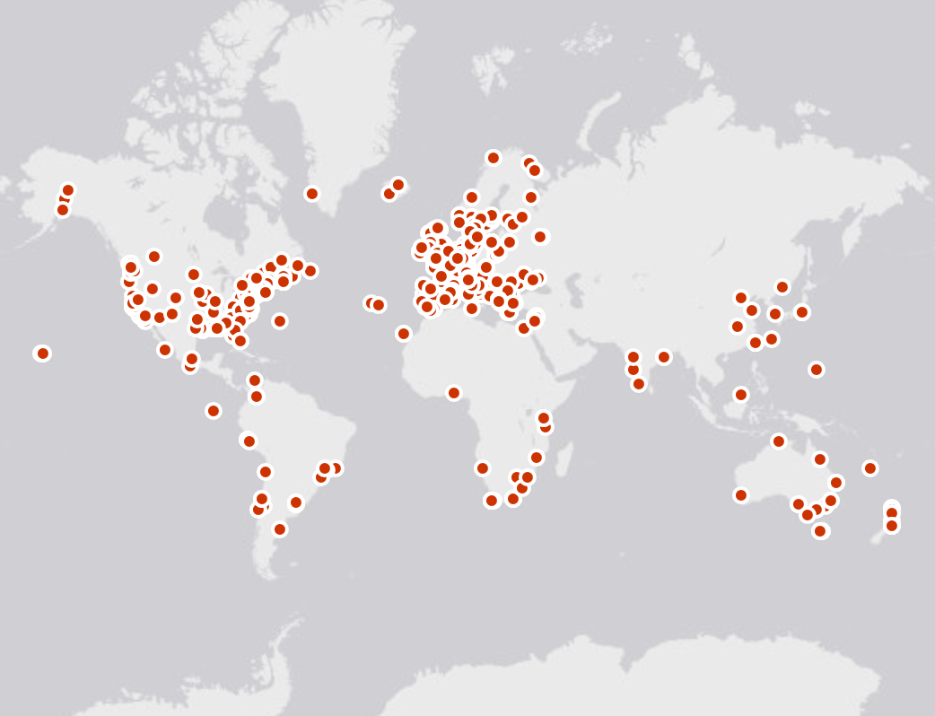
OBIS Nodes
Arctic OBIS
DeepSeaOBIS
OBIS Canada
Oceans Past
OBIS HAB
iOBIS
OTN
OBIS USA
FishBase
OBIS China
MicrOBIS
EurOBIS
Black Sea OBIS
KOBIS
OBIS SEAMAP
MedOBIS
PEGO-OBIS
OBIS Japan
CPPS OBIS
Caribbean OBIS
OBIS Senegal
IndOBIS
SEA OBIS
WSAOBIS
ESPOBIS
AfrOBIS
OBIS Australia
South Western Pacific OBIS
ArOBIS
AntOBIS
Notes:
The data from these 600+ institutions is provided to OBIS through more than 20 national, regional or thematic OBIS nodes. They standardize and quality control the data, so OBIS can easily integrate them in a single database. The central system is maintained here at the OBIS secretariat in Oostende.

Slide 7
OBIS Data Network (Nodes)
OBIS’s data network organised in a hierarchical structure of nodes
Tier 1 = OBIS secretariat at IODE
Tier 2 = Regional and Thematic Nodes (NODC’s like OBIS Canada and ADUs like OTN)
Tier 3 = Local Nodes (NODC’s and ADU’s)
Notes:
OTN – Tier 2 Node – thematically about biologging and machine observation of animal presence.
Tier 3 – local nodes, more geographically concentrated National Ocean Data Centers and Associated Data Units.

Slide 8
OBIS nodes ToR
Receiving or harvesting marine biodiversity data (and metadata) from national, regional and international programs, and the scientific community at large.
Perform data validation (using standards, tools and best practices), as described in the OBIS manual.
Reporting the results of quality control directly to data collectors/originator.
Making data (and metadata) available to OBIS using agreed upon standards and formats (OBIS cookbook).
Control data access, terms of use and sharing policies.
Provide customer support (data queries, analyses, feedback).
Increase visibility and reach out (Communication and Outreach Strategy).
Build customized portals (e.g., multiple languages).
Comply with the IOC data policy for using and sharing OBIS data.
Notes:
So, the ToR of national and thematic OBIS nodes reads a lot like the obligations we’re all already under as Canadian federal employees and academics to serve the biodiversity data we collect to the public. Take in data, validate it, report the results back to the originator but also make it available publicly in useful formats, enforce the terms of use and sharing policies you’re obligated to enforce, help people access and use the data you’re expressing, assist in discovery of this data by new potential users, build portals to mirror this data to new audiences, and comply with the data policy for your organization and that your partners have agreed to, OBIS nodes respect the IOC data policy, which is likely very compatible with our own data reporting obligations.

Slide 9
What does it mean at a technical level?
Providing multiple datasets in a standard format for harvesting by iOBIS (Darwin Core Archive format)
Having complete and good quality data and metadata for each dataset
Regular updates to the datasets where possible
IPT Server to serve the datasets (or use the IPT server of iOBIS to upload datasets)
Notes:
The technical responsibilities of OBIS nodes are to provide datasets as DwC archives to be harvested by iOBIS, ensure incoming data and metadata are of good quality according to the norms of the OBIS community (which change but not so quickly). Make updates to the datasets as they grow, and host the results on an IPT server, either their own or via an existing IPT service at either iOBIS or the upstream NODC, to upload your datasets. Before OTN got ADU certified and started running our own IPT, we were publishing all our datasets via OBIS Canada.

Slide 10

https://bit.ly/2YNXUrR
“OBIS Canada” is the Canadian regional OBIS node and along with the Ocean Tracking Network thematic OBIS node represents Canada’s contribution to this global initiative.
Fisheries and Oceans Canada supports OBIS by managing the OBIS Canada node and contributing datasets.
OBIS Canada was recognized as a National Activity by the National Science Data Management Committee of Fisheries and Oceans Canada in 2010.
Notes:
So now let’s look at OBIS Canada, part of our home and native National Ocean Data Centre and OBIS node. The URL is not great to type out, and I sometimes have a hard time finding it, but I made a bit.ly link if people want to follow along on the site itself. Since 2010, it’s been a recognized National Activity, and we’re here today with its incoming Node Manager, Maria Cornthwaite.

Slide 11
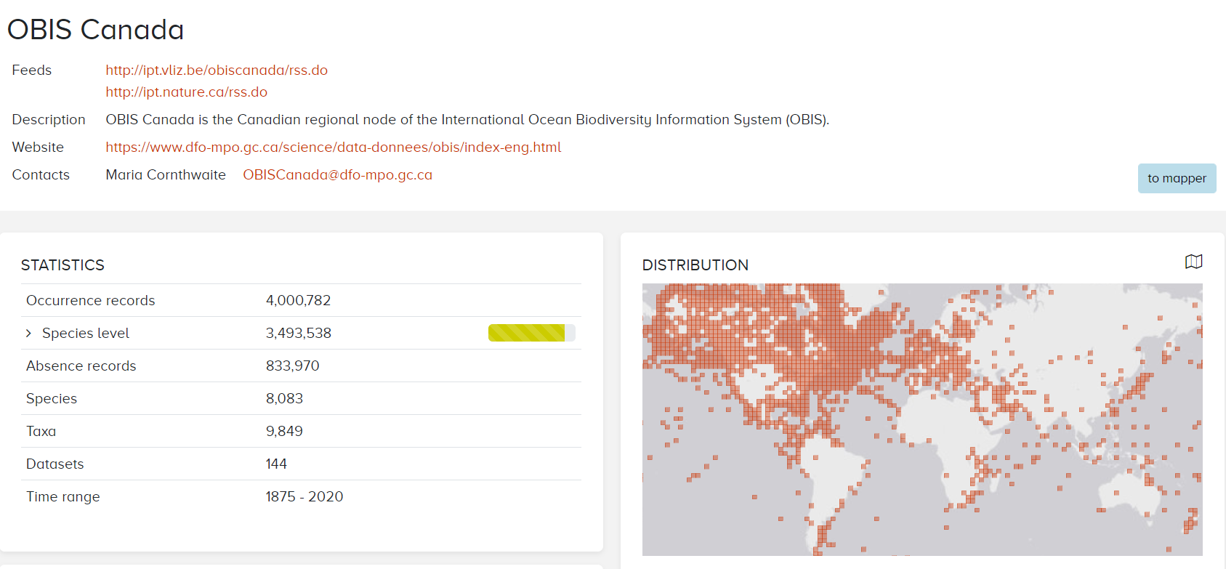
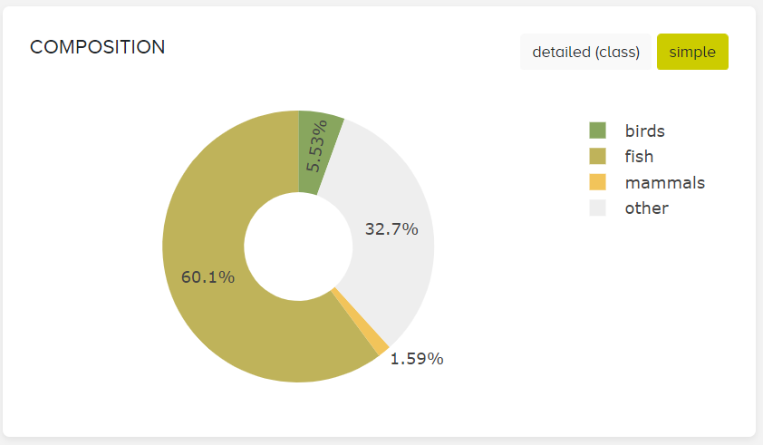
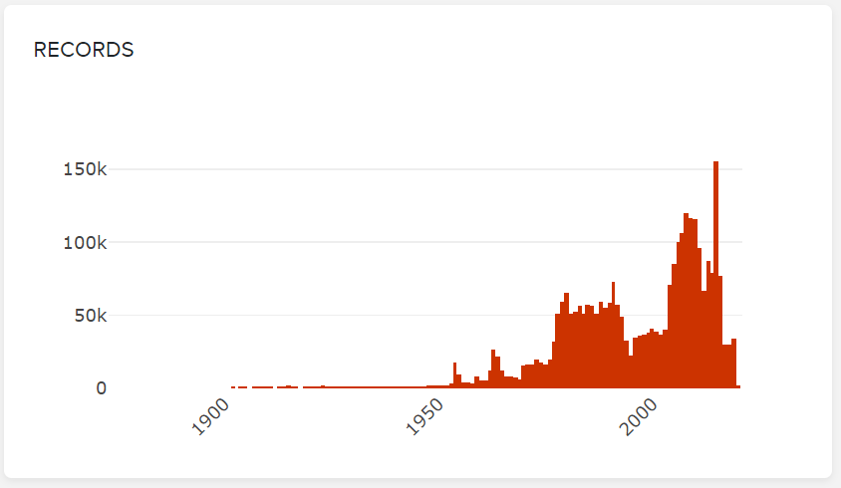
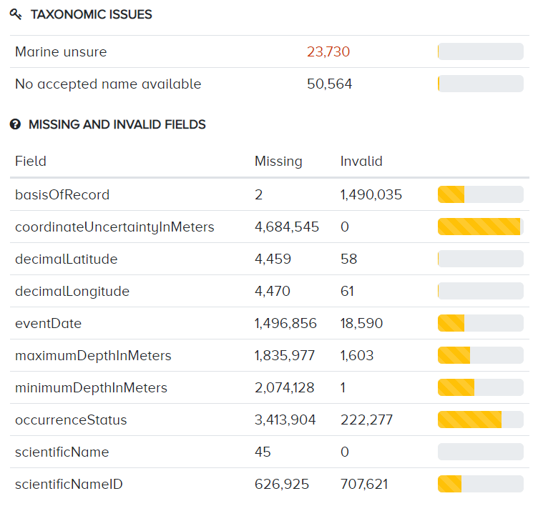
https://bit.ly/2YNXUrR
Notes:
So I grabbed a few highlights from this stats page for the OBIS Canada node on the OBIS website. Every node has one, there’s a lot of summary stats and plots describing the scope of coverage of this node’s datasets. We see a lot of good Canadian coverage, but also our contributions to global sampling initiatives that give the data in the OBIS Canada node a global scope. The temporal resolution is pretty good too, with tens of thousands of records per year available for as far back as the 1960s, and a glut of data as we more further into the digital age. A point to make here, older datasets have value in a data system like OBIS, I believe some of the oldest records in OBIS from Canadian waters involve cod landing by Newfoundland fishermen in the time of John Cabot. Finally we have some numbers to back up the Heritage minute.

Slide 12
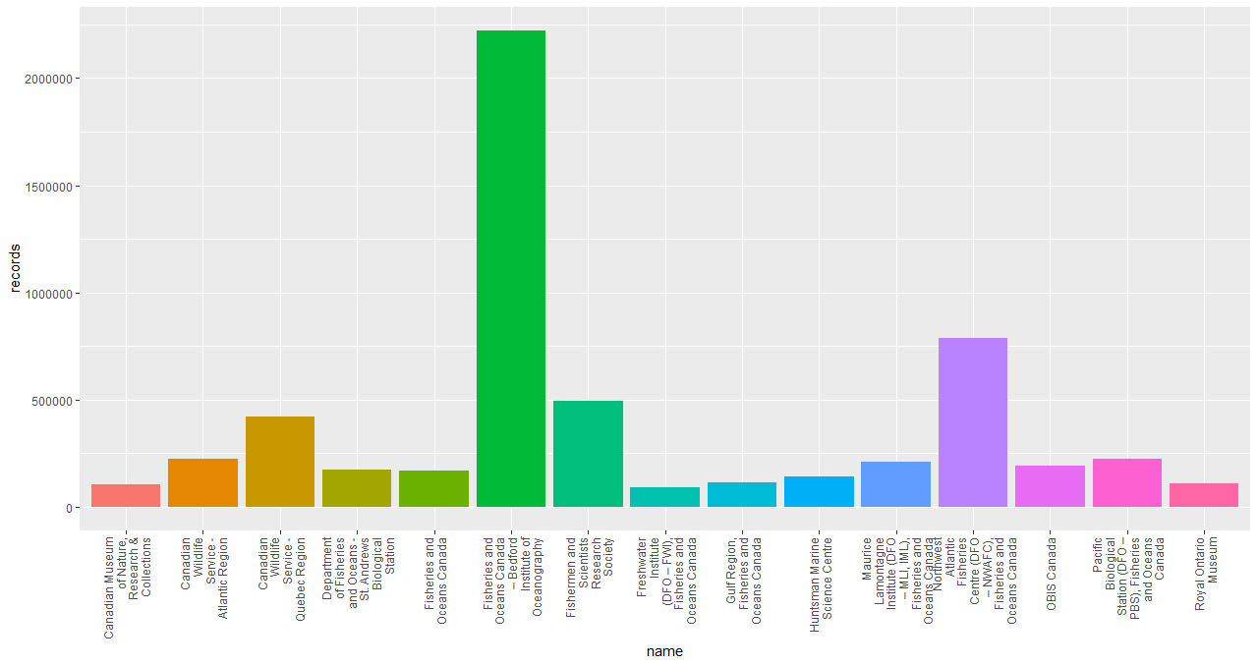
https://bit.ly/2YNXUrR
Institutions contributing the most records to OBIS Canada
Notes:
These datasets come from many contributing partners, with large contributions coming from each of the DFO institutes, the Canadian Wildlife Service, universities like Dalhousie and Universite du Quebec, the Canadian Museum of Nature, as well as some private collection efforts. Though the vast bulk of what’s currently in OBIS Canada comes from DFO institutions, we know there’s more to do. For a long time, OBIS Canada was headquartered at BIO in Halifax, NS, and that history has a lot to do with why it’s so far in the lead in terms of records reported to OBIS. Now that OBIS’s home is in the Pacific region, I expect that we will continue to see this growing effect at places like PBS, perhaps with contributions from your efforts this week and going forward!

Slide 13
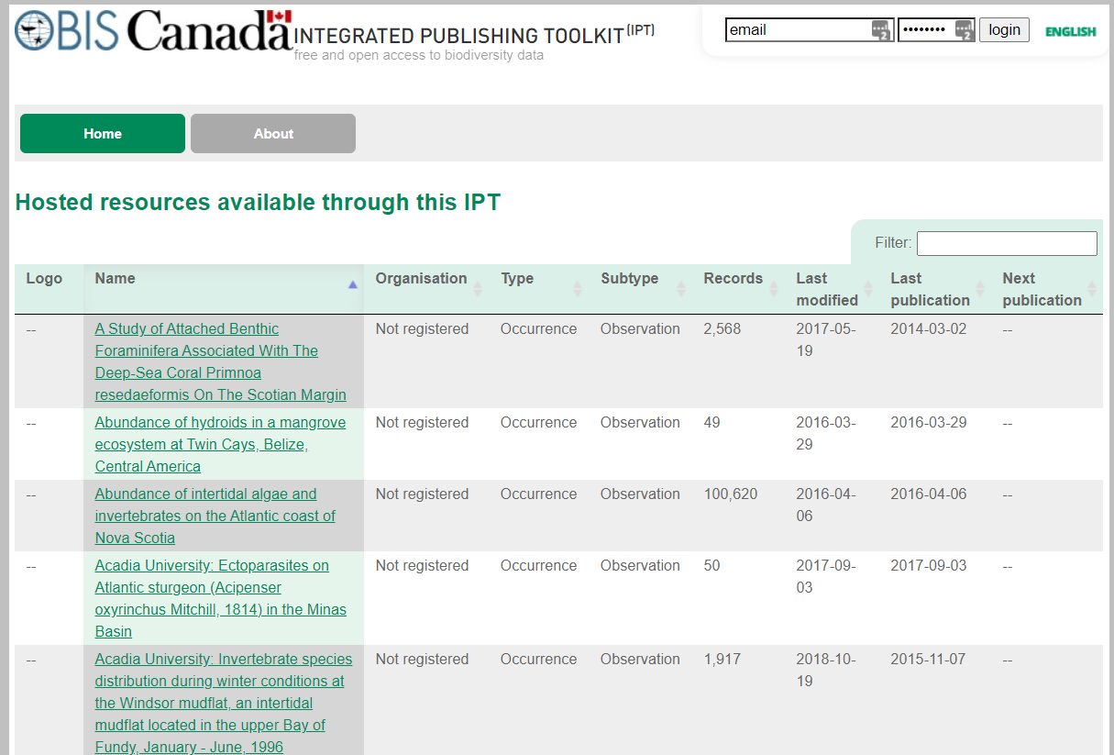
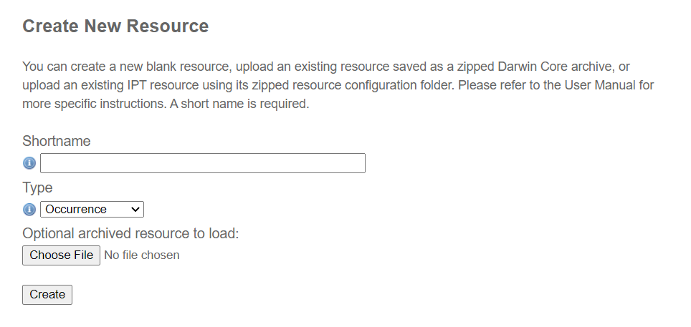
http://ipt.iobis.org/obiscanada/
Notes:
So after lunch today, we’re going to have a hands-on session where we package up our formatted and QCed datasets into a darwincore archive, according to one of the Core/Extension schemas we talked about, and submit it to OBIS Canada’s IPT service. Once it’s ready for publication, you can login to the OBIS Canada IPT and submit it as a new Resource. Then the IPT will scan your archive, give you some pointers on what may still be off, and once that’s all cleared up, an OBIS Canada rep can approve and publish your dataset.
Again, if you didn’t bring a dataset, we can either pair you off with someone to work on theirs, or if you’re keen, you could help with other projects like the translation of metadata and data from some other popular repositories, I know a lot of folks use Open Canada to publish datasets, and I think it could be very generally useful to have a mechanism to replicate those datasets into OBIS Canada.

Slide 14
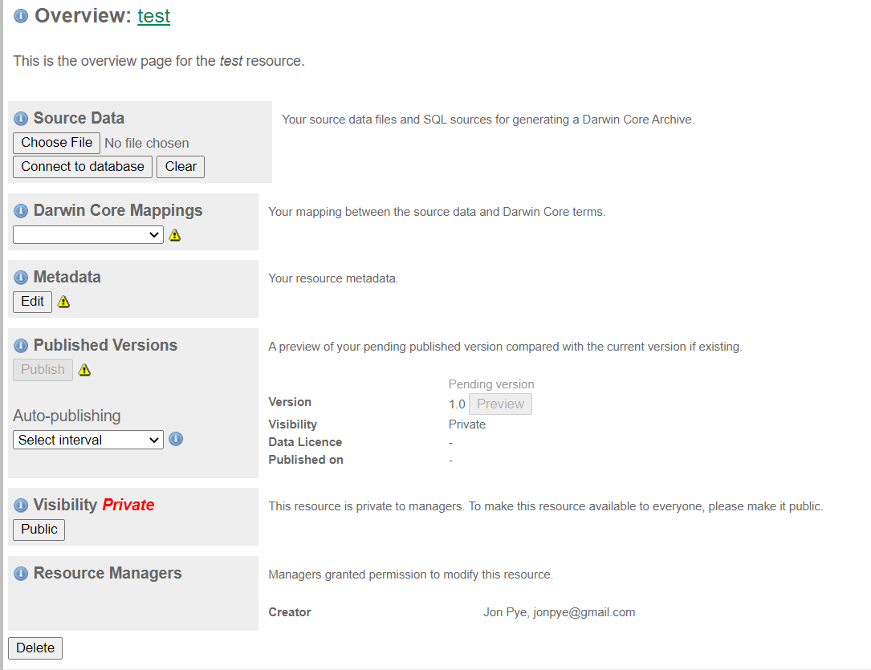
http://ipt.iobis.org/obiscanada/
Notes:
So once you create your collection, you can upload source datafiles, create mappings from the datafiles to DarwinCore terms, enter metadata in the form that conforms to the EML requirements. The IPT will then build the appropriate EML into the archive. One thing we’re not going to do just yet is hit visibility = ‘Public’ or ‘Publish’, before we do a quick review.

Slide 15
OBIS Node health status check;
transition strategy for inactive OBIS nodes
SG-OBIS evaluates the health status of OBIS nodes at each annual SG meeting
An OBIS node is considered inactive when it meets any of the following conditions:
The OBIS node manager recurrently fails to answer the communications from the project manager or the SG co-chairs in the last 12 months
The OBIS node manager or a representative fails to attend (personally or virtually) the last 2 SG meetings without any written reason
The OBIS node does not have an IPT
The OBIS node has an IPT, but it has not been running for the last 12 months
The datasets in the OBIS node's IPT have been removed and not restored in the last 12 months (without any explanation)
The OBIS node has not provided new data for the last 2 years
Notes:
So OBIS’s steering group evaluates the health of its Nodes at each of the SG meetings, and an OBIS node gets ticked over to inactive when it meets any of these conditions:
[ read slide ]
so you’ve got to keep in touch with the community, often on your own dime when it comes to attending the meetings and infrastructure, and be keeping your data portal active and running and have new data flowing through it.

Slide 16
OBIS Node health status check and transition strategy for inactive OBIS nodes
SG-OBIS
Option 1: submit action plan
OBIS node
OBIS node
OBIS node
IODE
Option 2: recommend to IODE removes OBIS node
Notes:
The SG-OBIS members representing active OBIS Nodes will make one of the following decisions:
Request the inactive OBIS node to submit a plan with actions, deliverables and times to improve their performance, within 3 months, to the OBIS Secretariat. This plan is reviewed and accepted by the OBIS-Executive Committee
Or
Provide a recommendation to the IOC Committee on IODE to remove the OBIS node from the IODE network.
In either case, the OBIS Secretariat will inform the OBIS node manager of the SG-OBIS decision, with a copy to the IODE officers and the IODE national coordinator for data management of the country concerned.
The IODE Committee is requested to consider the recommendation from the OBIS Steering Group and it may either accept the recommendation or request the inactive OBIS node to submit an action plan (option 1).
When the inactive OBIS node is removed from the IODE network, the SG-OBIS will ask whether another OBIS node is interested in taking over the responsibilities of the removed OBIS node, until a new OBIS node in the country/region is established.

Slide 17
OBIS Contact Information
OBIS Canada
Node Manager: Maria Cornthwaite
Email: OBISCanada@dfo-mpo.gc.ca
Ocean Tracking Network
Node Managers:
Jonathan.Pye@dal.ca
Lenore.Bajona@dal.ca
OBIS Secretariat
UNESCO-IOC Project Office for IODE
Wandelaarkaai 7/61, 8400 Oostende, Belgium
Project Manager: Mr Ward Appeltans
Phone: +32 59 34 01 76
Email: w.appeltans@unesco.org
Notes:
You can find contact information for Maria, OBIS Canada’s manager, on the IODE website, and for myself and Lenore Bajona, who manage the Ocean Tracking Network OBIS node, and for the international OBIS project manager, Ward Appeltans. The OBISCanada email address is your first point of contact to assist with publishing your datasets, though I have also been known to try my best when questions land in my inbox.

Slide 18
OBIS guidelines on the sharing and use of data
Notes:
So, one of the requirements for OBIS nodes is to follow IOC data policy guidelines. So let’s go over what those are and how OBIS conforms to them.

Slide 19
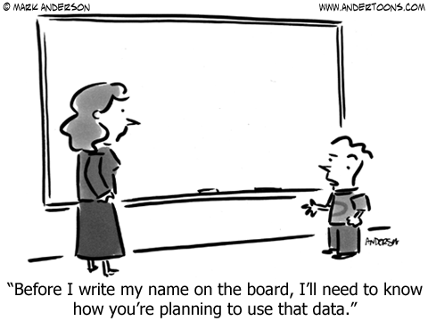
Notes:
We live in an era of rampant personal data misuse, and I don’t know what your experience is with data providers, but they’re very interested in how and where their data will be shared.

Slide 20
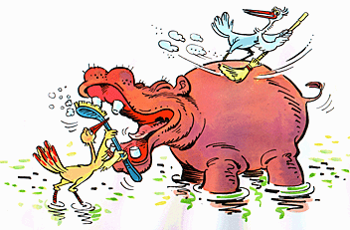
Data Manager & Researchers
Notes:
Ideally, our role as data managers and infrastructure providers would be symbiotic and beneficial to all involved. We provide a valuable service to the research community, and that community benefits from the increased reliability, quality control, archival and discoverability that good data management groups can offer them, both in writing grants and in

Slide 21
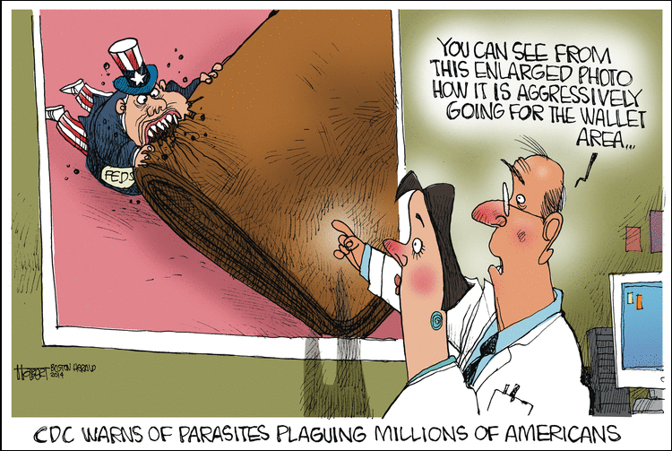
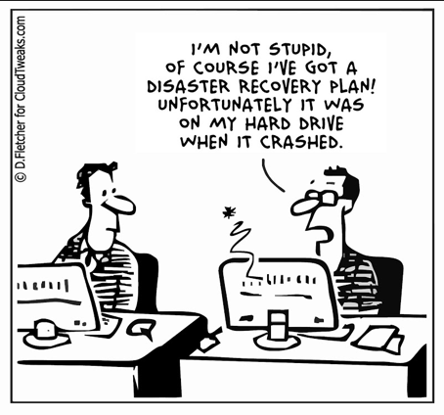
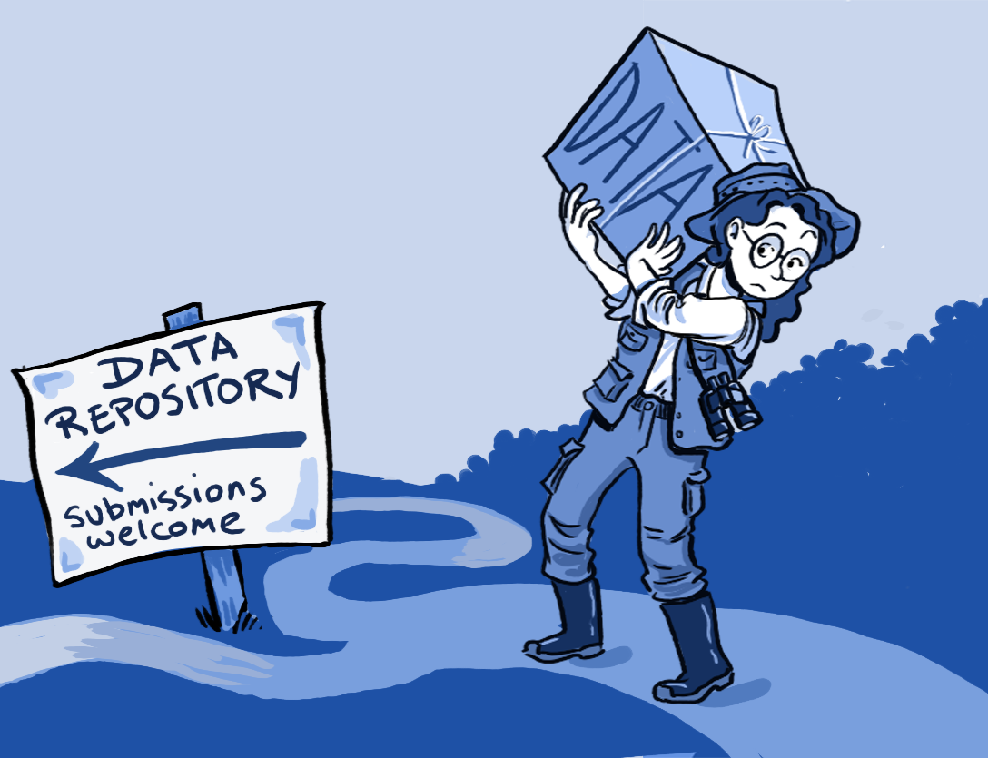
The reality…
Notes:
In reality, researchers can see data management as an extra cost they’re not used to paying for, [click] and data managers see the precariousness of throwing millions of dollars into a research programme without any idea of how the outputs will be protected and shared with the public. [click]. Ideally, we’d be viewed as a crucial resource, a way for researchers to unburden themselves of having to curate and advocate for their data after they have collected and analyzed it.

Slide 22
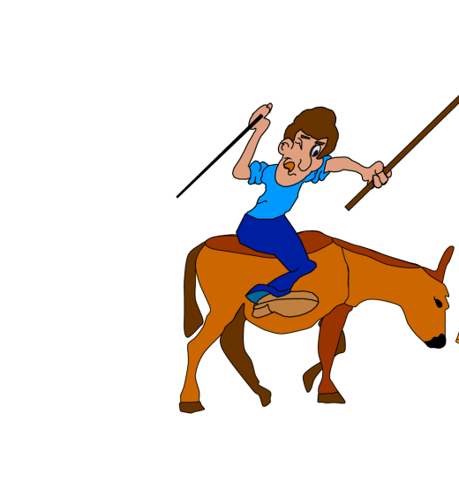
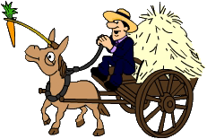
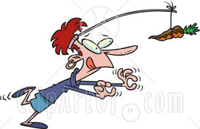
Data sharing
The sense and non-sense of data sharing…
How to convince data custodians to share their data?
“Stick”
Legal obligations written into contracts
“Carrot”
Make it advantageous for everyone to share data
=> breaking the prisoner’s dilemma
Notes:
For disciplines that have not undergone the data sharing revolution, there’s the added requirement to convince or constrain data providers to share their data with the public at all! Oceanographers see a plain public benefit to their data becoming public, but this was not always the case. So either we find a stick to beat them into compliance, that’s contracts or grants that require data sharing, or we find the carrots that will entice them to share. There is a bit of a prisoner’s dilemma at play in fields of study where sharing is not the norm.

Slide 23
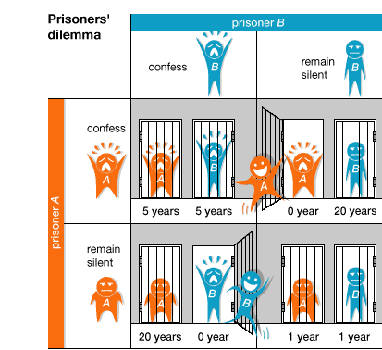
The prisoners’ dilemma
Best choice => both stay silent (= both serve 1 year)
BUT: no guarantee that the other one will remain silent!
Actual outcome => “rational choice” is to betray or ‘cheat’ on companion
Notes:
And,if you need a recap of what the prisoner’s dilemma is, it’s the idea that if one person acts a certain way while the other does not, they put themselves at a disadvantage. For prisoners, this means staying silent vs. confessing to a crime. If all confess, they get larger sentences than if none do, but if only one confesses, and the other doesn’t, the one who doesn’t confess faces a huge disadvantage!
In this analogy, sharing data is equivalent to remaining silent. Confessing, or ratting out your friend, is equivalent to hoarding your data. Somewhat confusing, stay with me!

Slide 24
“Cheater” earns the highest rewards:
Scientist A & B each have a dataset
A shares data, B doesn’t
B can write papers on combined dataset, A can’t
How to break the prisoner’s dilemma?
Building up trust relationships
Provide in good data policies
Increase advantages of data sharing / data publication
Citation of datasets
Co-authorship
Data sharing = iterated prisoner’s dilemma
Notes:
So the cheater gets the reward if he’s the only cheater. But if nobody cheats, everyone is better off in aggregate. If we all share, everyone gets the benefit! So how do we discourage cheaters? Build trust between ourselves and our providers, provide good data policies that tell the providers what they can expect, and enhance the advantages for data sharers. Increased citations, co-authorships, data papers.

Slide 25
IOC oceanographic data exchange policy
Adopted by Resolution IOC-XXII-6 (2003)
http://www.iode.org/policy
IOC programmes:
Clause 1: Member States shall provide timely, free and unrestricted access to all data, associated metadata and products generated under the auspices of IOC programmes
Other programmes:
Clause 2: non IOC programmes are encouraged to apply clause 1
Clause 3: encourage clause 1 and 2 for non-commercial use (research and education)
Clause 4: right to determine the terms, in a manner consistent with int conventions
Clause 5: archive your data in NODCs, etc.
Clause 6: Member States shall build capacity in developing countries
Notes:
So those are our motivations when we write data policy. We want to break this prisoners dilemma, and push people onto the virtuous path of data sharing by carrot, because we don’t have any sticks. The funders have sticks, and if they know about our carrots they can use those sticks on our behalf but I’m getting too into these metaphors.
The IOC data policy for IODE, member states shall provide timely, free and unrestricted access to all data, metadata, and products generated under IOC programmes. There’s a big stick! This creates a class of behavior at the highest level to share data. Clause 2 – boils down to if you’re not under the IOC mandate, you should still apply clause 1 if you can! No stick here, just wishing. Clause 3 – the IOC encourages clauses 1 and 2 for all non-commercial applications. That puts a stake in the ground for funding bodies for those groups, here’s the standard for nations and international programmes. Shouldn’t your grantees meet it? Clause 4, keep the terms of compliance within the conventions of the international community, basically allow for edge cases and equitable dealing across different levels of capacity. Clause 5, encourages the behavior we covered earlier, providers should use their NODCs and ADUs where they find them. Clause 6, we should work to build capacity in developing nations.

Slide 26
OBIS license?
OBIS does not own the data (the data providers retain ownership of the data provided), but OBIS has been given the rights to publish/distribute the data via its online open-access data portal.
The integrated OBIS database is a new product created by OBIS, now under the auspices of IOC-UNESCO. This means that clause 1 of the IOC data exchange policy applies: OBIS shall provide timely, free and unrestricted access to all data, associated metadata and products.
Notes:
OK so how does this apply on the OBIS level? OBIS doesn’t take ownership of data provided to it, but has been granted the right to publish/distribute it via its portal (the Integrated Publishing Toolkit).
This –new- product, the OBIS database, lives under IOC-UNESCO, and is therefore subject to Clause 1. OBIS will provide timely, free and unrestricted access to all that data, metadata, and associated products.

Slide 27
Dataset use constraints
High variety of restrictions on the use of OBIS datasets
From no restrictions:
No information or just a weblink or disclaimer;
Commercially available, to:
To more severe restrictions:
Freely available if cited (4 levels: record, dataset, OBIS node, OBIS);
Include co-authorship in case a substantial amount of the data is used;
Do not use without permission;
Do not use for commercial purposes without permission;
Do not redistribute to third parties without permission.
Notes:
On a per-dataset level, the provider retains a good deal of control over what that means in practice.
From no restrictions at all – that means no need for accreditation or provenance, and the ability to use it commercially, all the way through to more severe restrictions, attribution-required, co-authorship for substantial data usage, by permission only, no commercial, and no redistribution.
Everything covered by the Creative Commons family of licenses is permitted to be attached to datasets individually, and additionally the right to redistribute can be restricted.

Slide 28
Implications?
Citations, co-authorship, non-commercial use and explicit permissions…
How can we enforce, control, monitor, police violations?
=>not the responsibility of OBIS
=>aren’t we making it impossible to use data from OBIS?
=>is allowing these restrictions just a way to convince scientists to provide their data?
Notes:
Attaching licenses to these datasets doesn’t create obligation on the part of OBIS or your part, when you’re publishing data with licenses you are asking the end users to respect your terms, but they’re never obligated to do so. So why do it? Are we just trying to make scientists feel better about giving us their data? It certainly has that effect, but I think there are reasonable use cases for all the CC classes certainly, and I can understand the desire not to see data redistributed without control.

Slide 29
Which license should we promote?
For OBIS, as a data aggregator, it would be a lot easier if the whole community accepts a single, clear and open license that allows maximum use of the datasets.
Creative Commons Zero (CC0) license
With CC0 you waive any copyright you might have over the data(set) and dedicate it to the public domain
Users can copy, use, modify and distribute the data without asking your permission.
You cannot be held liable for any (mis)use of the data either.
Notes:
OBIS has made the decision to encourage the use of CC-0, it’s maximally permissive for data users, doesn’t put too many restrictions on them, and keeps liability away from data providers. So they’re encouraging their contributors to adopt that license wherever possible.

Slide 30
Which license should we promote?
What about attribution?
Although CC0 doesn’t legally require data users to cite the source, it does not take away the moral responsibility to give attribution, as is common in scientific research.
There is no license attached to scientific papers that says you have to cite the paper when used, but it is common practice in science.
Notes:
Attribution’s not covered in CC-0, but there’s still a moral responsibility for researchers to credit the data they use when writing papers and producing reports. And to that point, there’s no license on papers you read that say if you use the idea you have to cite it when you use it in non-academic ways, but there’s a powerful convention and history in the community that enforces that idea, and it works out.

Slide 31
What license for the OBIS database?
The OBIS database, and any products are published under the Creative Commons Zero (CC0) license.
Promote FAIR use…
Encourage people to build applications using the data access webservices, rather than maintaining a copy of OBIS
Respect the data providers, and provide helpful feedback on data quality.
When you are both a data user and a data custodian yourself, you should also publish your data to OBIS
Consider sponsoring or partnering with OBIS and its OBIS nodes
Notes:
So, given all that, the OBIS database itself is distributed under CC0. people can build applications using the webservices instead of seeking local copies for the sake of reliability. OBIS encourages users of the data to respect the data provider and give feedback on data quality. When you wear both hats, as a data user and a custodian, you should set a good example and publish your own data to OBIS. And if you’re in a position to do so, and you find OBIS useful and good, you should sponsor or partner OBIS or its nodes where you can. This includes maintaining an OBIS node.

Slide 32
Good advice: Develop a Data Policy in your institution
A data policy should contain:
Identify the data use license, preferably based on Open-access principles (you can refer to the IOC data policy)
Describe fair use
Describe your needs
Describe data ownership
Provide disclaimer
Provide citation guidelines
Notes:
I don’t need to preach this one for you folks, we know the benefits of our data policies, but we encourage every institution we interface with to develop data policies, with associated licenses if applicable, covering the appropriate use of the data they collect, the obligations to the data provider that will allow the provider to benefit from or receive credit for the use with the appropriate parties, describe data ownership, provide any disclaimers necessary, and give guidance on citing the data properly.

Slide 33
“Advice to a Young Investigator” (1897):.
“A scholar's positive contribution is measured by the sum of the original data that he contributes. Hypotheses come and go but data remain.”
Santiago Ramón y Cajal
(Nobel Prize winner in 1906)
Notes:
We are what we leave behind. This is a wonderful quote [read it]. I have heard it expressed in other ways, less kindly, as i’ve heard it shouted across a room during a data policy meeting ‘What do you think is going to happen to your data when you die!?’. That was a really good meeting.
Any questions on data policies? I’ll do my best. If we just want to talk about it for a few minutes here, there’s a good opportunity to do so now.

